Slide 1

IST 261 (Fall 2019)
Application Development Design Studio I
Writing JavaDoc Comments
Phil O'Connell
pxo4@psu.edu

Slide 2
What is JavaDoc
It's a special variation of normal comments in your code
You can then generate HTML documents from those comments
And if you want, then covert that HTML to PDF, or other formats
JavaDoc is also used from within most IDEs for popup help
JavaDoc comments begin with /** ("slash star star")
As opposed to the traditional /* ("slash star")
They end with the traditiona */ ("star slash")

Slide 3
Tags
Within the JavaDoc comments, you can include tags
There are about 20 available to use
But for this course, we'll use these
Email is not traditional.
But we'll use it here for class
Tag | Meaning
@author Jo Student (jxs5123@psu.edu) | Name of the author (email in parens)
@param studentId | Name of a parameter for a method
@return | Description of the value to be returned
In recent years, @author has been criticized as not needed, because revision control can tell you who wrote it
However, for this course, we'll use it

Slide 4
Example of JavaDoc for a class
/**
* Stores and manipulates a list of grades
* <p>
* The class allows decimal grades to be stored in a collection.
* <p>
* And also provides a way to retrieve <b>all</b> the grades,
* <u>regardless</u> of the collection type.
*
* @author Phil O'Connell (pxo4@psu.edu)
* @author Homer Simpson (hjs1@psu.edu)
*/
public class GradeBook
{
Short one-line description
Long description
List all the authors who contributed to this class
JavaDoc comments end the same as traditional comments

Slide 5
Example of JavaDoc for a method
If there are parameters, use @param for all of them
If the return type is void, then don't use @return
/**
* Insert a new grade
* <p>
* Given a new grade for the grade book, add it to the collection.
* <p>
* We are assuming the grade has already been validated by the caller
*
* @param grade the grade to be added
* @param extraCredit true if this is for extra credit
*/
public void newGrade(double grade, Boolean extraCredit) {
...
}
Short one-line description
Long description
Description of the parameter
Name must match

Slide 6
Example of JavaDoc for a method
If there are parameters, use @param for all of them
If there is a value returned, describe it with @return
/**
* Insert a new grade
* <p>
* Given a new grade for the grade book, add it to the collection.
* <p>
* We are assuming the grade has already been validated by the caller
*
* @param grade the grade to be added
* @return the equivalent letter grade
*/
public String convertGradeToLetter(double grade) {
...
}
There is no "name" for a return time in JavaDoc

Slide 7
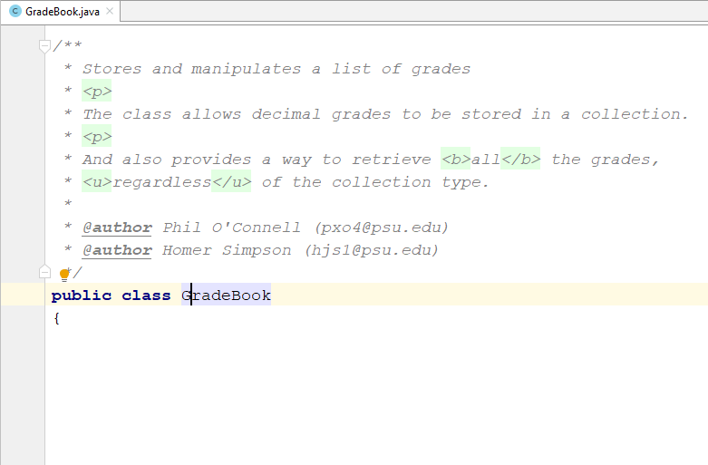
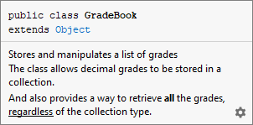
Seeing JavaDoc in the IDEA Editor
Put your cursor anywhere on a class or method
Hit Ctrl-Q

Slide 8
Generating HTML from JavaDoc
Most IDEs let you generate the HTML from JavaDoc

Slide 9
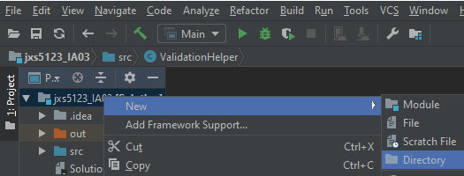
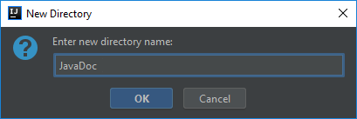
Right-click on the project > New > Directory
Right-click

Slide 10
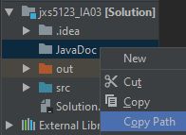
Right-click on the folder > Copy Path
Right-click

Slide 11
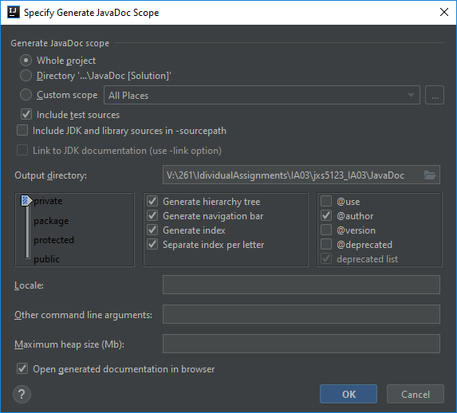

Tools > Generate JavaDoc
Paste the full path of the folder that you copied on the previous step

Slide 12
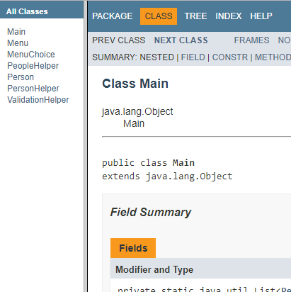
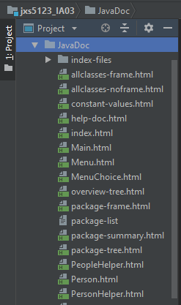
Your JavaDoc Will Open in Your Browser

Slide 13
Further Reading
https://docs.oracle.com/javase/9/javadoc/javadoc.htm
http://www.oracle.com/technetwork/java/javase/documentation/index-137868.html

